Slide 1
The CrashCatcher
Model
(Predictive Maintenance)
GROUP - 3

Slide 2
Team Members
Niharika Sai Lalitha
Kavana
Akhil
Anurag
Sidharth
Keerthi Tej

Slide 3
Predictive Maintenance

Slide 4
Predictive Maintenance
🚀 Definition: Predictive Maintenance (PdM) uses IoT sensors, AI, and data analytics to predict equipment failures before they occur, reducing downtime and optimizing efficiency.
🛠️ How It Works: 1️⃣ Data Collection – Sensors track vibration, temperature, pressure, etc. 2️⃣ Data Analysis – AI/ML models detect anomalies and failure patterns. 3️⃣ Failure Prediction – Alerts generated before breakdowns. 4️⃣ Actionable Insights – Enables proactive maintenance decisions.

Slide 5
Problem Statement

Slide 6
Problem statement
In the era of digitalization, optimizing maintenance schedules is critical for enhancing production efficiency. This project aims to leverage predictive maintenance techniques to analyze machine data and accurately predict the likelihood of machine failures, enabling smarter, data-driven decision-making for a more efficient and digital facility.

Slide 7
Complete Workflow

Slide 8
Complete Workflow
01
02
03
04
05
06
Describe the Dataset
Cleaning the Data
Checking Invalid records
Model Building and Deployment
Detect the Outliers
Data Visualization

Slide 9
Describing the Dataset

Slide 10
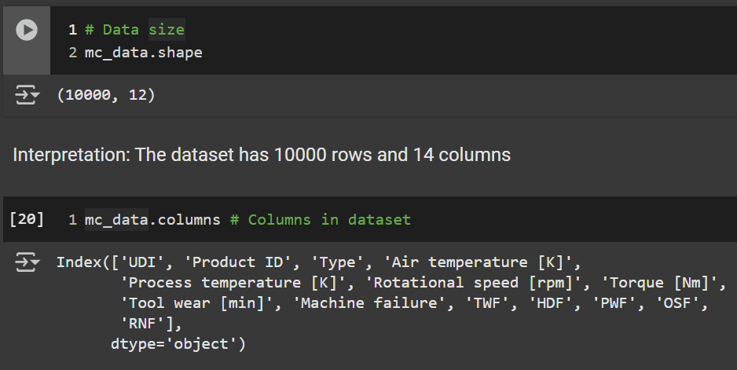
Describing the Dataset
Numerical Columns (Integers):
UDI: Unique identifier for data entries.
Rotational speed [rpm]: The rotational speed of the machine in revolutions per minute.
Tool wear [min]: The wear on the tool in minutes.
Machine failure: A binary indicator showing whether a machine failed.
Failure Types (Binary Indicators):
TWF: Tool wear failure.
HDF: Heat dissipation failure.
PWF: Power failure.
OSF: Overstrain failure.
RNF: Random failure.
Total Rows: 10,000
Total Columns: 14

Slide 11
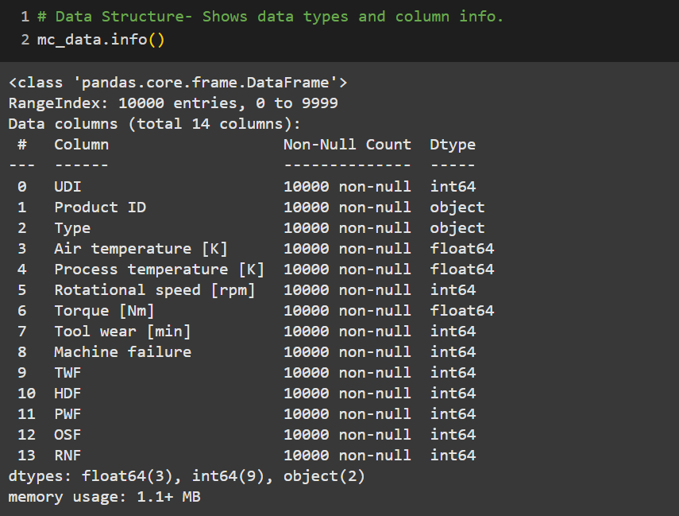
Describing the Dataset
Categorical Columns (Objects):
Product ID: Identifier for the product.
Type: The type of machine or product.
Numerical Columns (Floats):
Air temperature [K]: Air temperature in Kelvin.
Process temperature [K]: Temperature of the manufacturing process in Kelvin.
Torque [Nm]: Torque of the machine in Newton-meters.

Slide 12
Cleaning the data

Slide 13
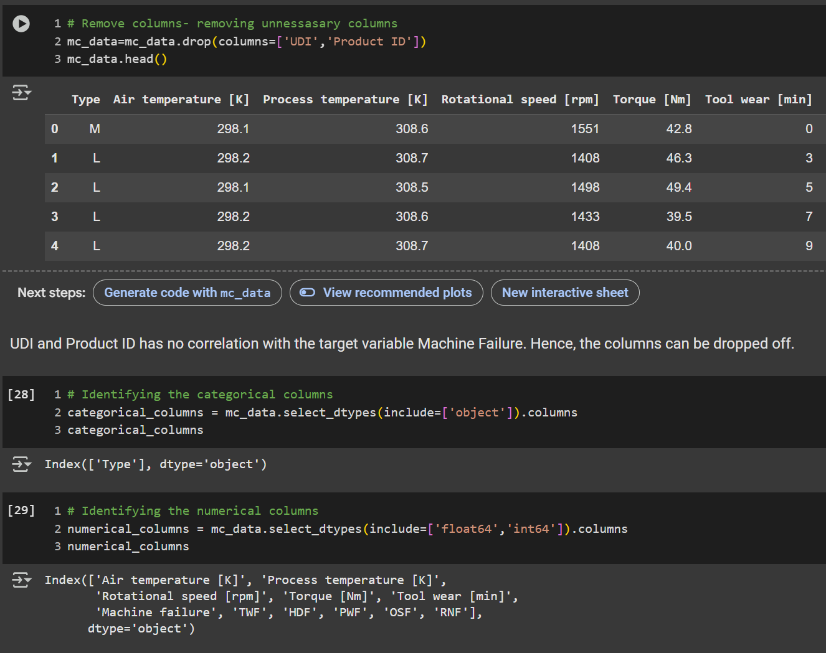
Cleaning the Data
Removing Unnecessary Columns
Columns Removed: UDI and Product ID
Identifying Column Types
Categorical Columns: Identified using select_dtypes with the object type.
These columns contain text or categorical data (e.g., Type).
Numerical Columns: Identified using select_dtypes with float64 and int64 types.
These include both continuous (e.g., Air temperature [K]) and discrete variables (e.g., Rotational speed [rpm]).

Slide 14
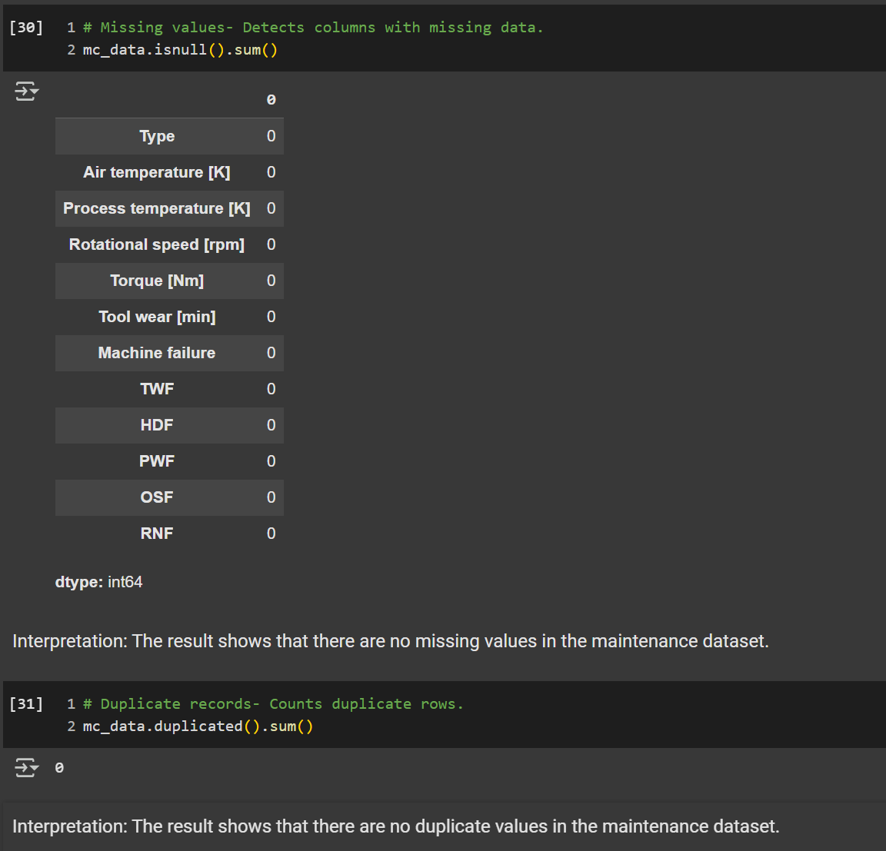
Cleaning the Data
Handling Missing Values
Missing Values Check: Used .isnull().sum() to identify any columns with missing data.
Result: No missing values were found in the dataset, so no further action was required.
Handling Duplicate Records
Duplicate Check: Used .duplicated().sum() to count duplicate rows in the dataset.
Result: No duplicate rows were found, ensuring data integrity.

Slide 15
Checking Invalid records

Slide 16
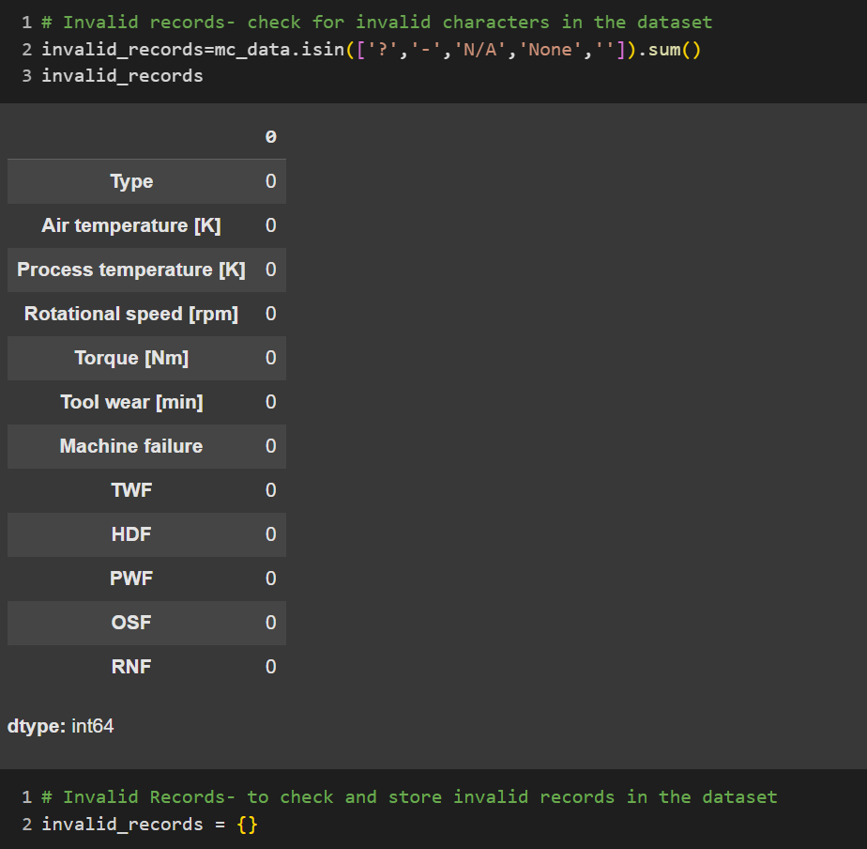
Checking invalid records
Detecting General Invalid Characters
The code checks for invalid characters in the entire dataset using .isin() with the following invalid values: '?', '-', 'N/A', 'None', and '' (empty strings).
invalid_records counts the occurrences of these invalid values in each column.
Checking Invalid Records in Binary Columns
Columns checked: ['Machine failure', 'TWF', 'HDF', 'PWF', 'OSF', 'RNF']
For each binary column, the code ensures that values are restricted to 0 or 1 using .isin([0, 1]).
If any invalid values exist (e.g., values other than 0 or 1), they are stored in the invalid_records dictionary.

Slide 17
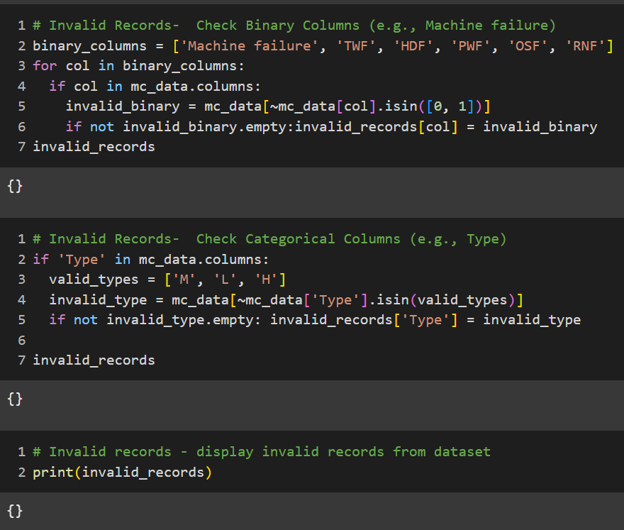
Checking invalid records
Checking Invalid Records in Categorical Columns
Column Checked: Type
Valid Values: ['M', 'L', 'H'] (likely representing machine types: Medium, Low, High).
Method:
The code checks if the values in the Type column fall within the valid set using .isin(valid_types).
Any rows with invalid types are stored in the invalid_records dictionary under the Type key.

Slide 18
Detect the outliers

Slide 19
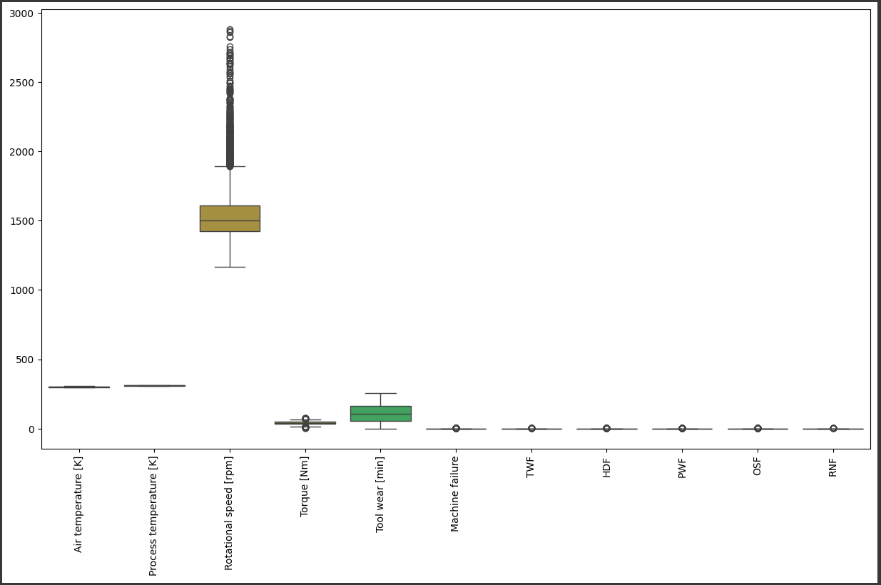
Detecting the outliers
Outlier Detection:
Visualization:
Boxplots are generated for all numerical columns to visually identify outliers.
Binary columns (Machine failure, TWF, HDF, PWF, OSF, RNF) can be excluded from outlier detection since they only contain 0 and 1 values.
Method Used:
The IQR (Interquartile Range) method is applied to detect outliers for the selected numerical columns:
Air temperature [K]
Process temperature [K]
Rotational speed [rpm]
Torque [Nm]
Tool wear [min]

Slide 20
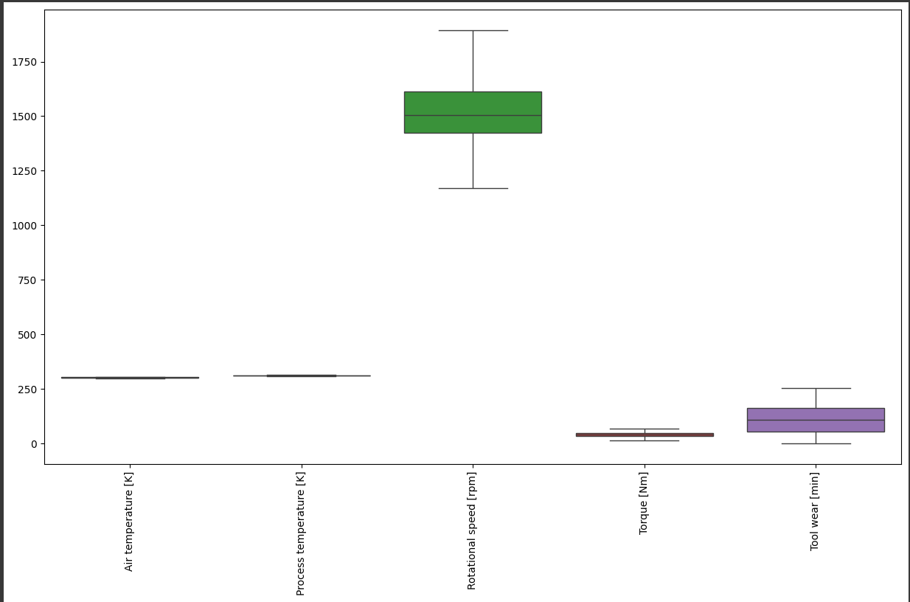
Detecting the outliers
Outlier Handling:
Capping Approach:
For each numerical column, any value below the lower bound is replaced with the lower bound.
Similarly, values above the upper bound are replaced with the upper bound.
This preserves the size of the dataset while bringing extreme values closer to a statistically acceptable range.
Post-Handling Visualization:
After capping, boxplots are regenerated for the selected numerical columns to confirm that outliers have been addressed.

Slide 21
Data Visualization

Slide 22
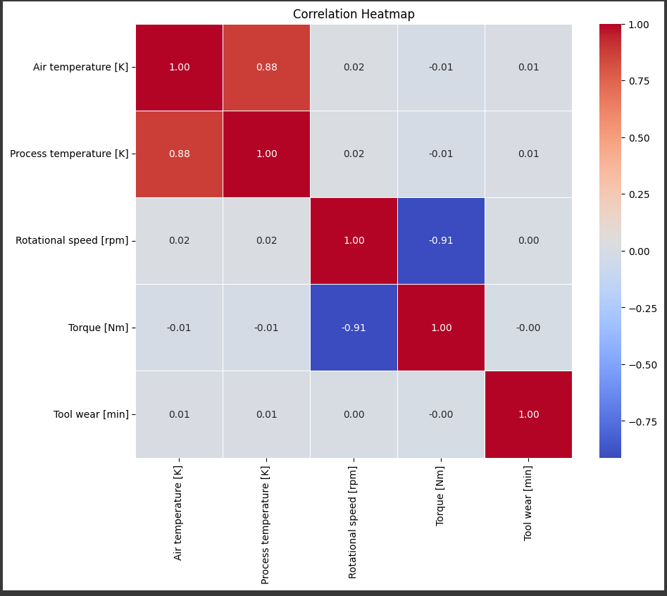
Data Visualization
Correlation Heatmap:
To identify the relationships between numerical features.
The correlation matrix (corr()) is computed for the selected numerical columns.
The sns.heatmap() function visualizes the correlations, with values annotated for easy interpretation.
A strong positive correlation (≈+1\approx +1≈+1) or strong negative correlation (≈−1\approx -1≈−1) indicates a strong linear relationship between features.

Slide 23
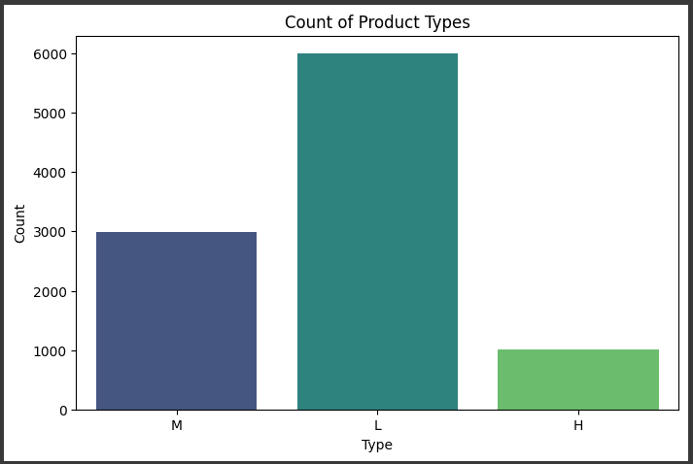
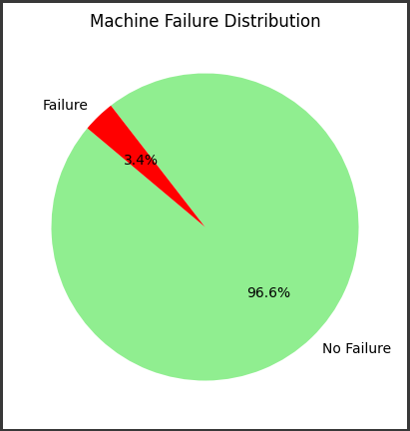
Categorical Feature Analysis:
To analyze the distribution of the Type categorical feature.
A count plot is generated for the Type column using sns.countplot().
Different product types are counted and displayed, with distinct colors for each type (via the "viridis" palette).
Machine Failure Analysis:
To analyze the distribution of the target variable (Machine failure).
The value_counts() function counts the occurrences of failures and non-failures.
A pie chart visualizes the proportions of machines with and without failures.
Colors: Green for "No Failure" and Red for "Failure."

Slide 24
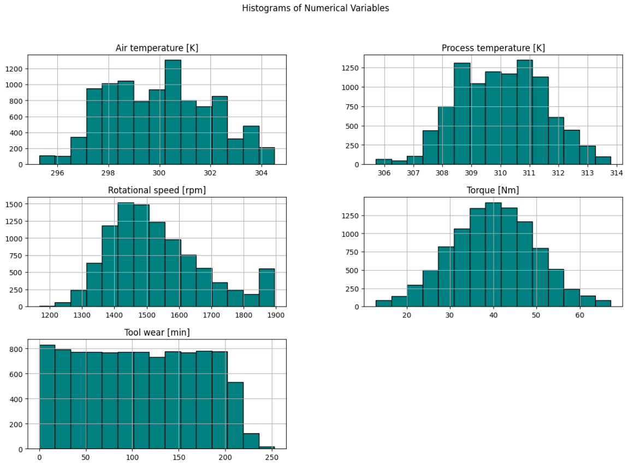
Data Visualization
Histograms of Numerical Variables:
To analyze the distribution of numerical features.
Histograms are created for all selected numerical columns using mc_data[filtered_numerical_columns].hist().
The number of bins is set to 15 for better granularity.
Each histogram is displayed with a teal color and black edges for clarity.

Slide 25
Model Building

Slide 26
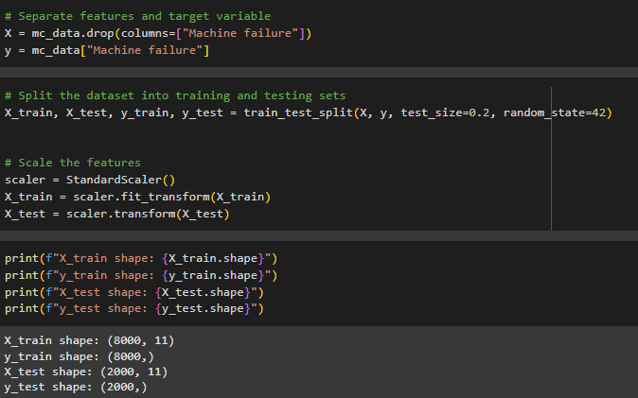
Separate Features and Target Variable:
X: All features excluding Machine failure.
y: The target variable Machine failure.
Train-Test Split:
The dataset is split into training (80%) and testing (20%) sets using train_test_split.
Ensures the model is trained and evaluated on separate data.
Feature Scaling:
Features are scaled using StandardScaler to standardize them (mean = 0, std = 1).
Scaling ensures numerical stability for certain models (e.g., Logistic Regression, SVM).

Slide 27
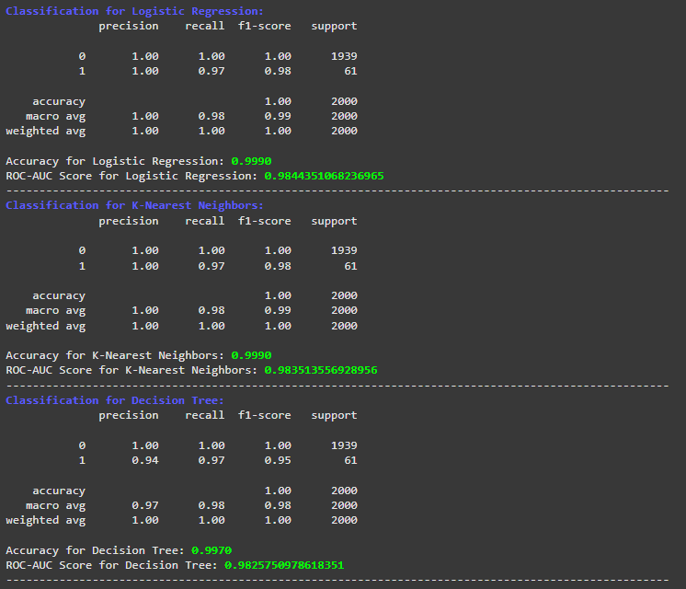
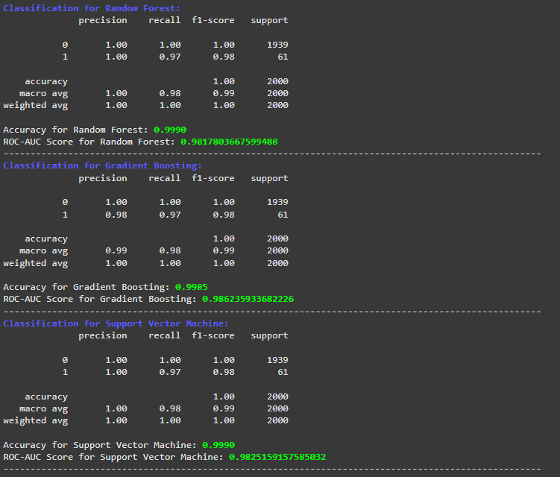
Model Training and Evaluation:
a. Model Selection:
Logistic Regression
K-Nearest Neighbors
Decision Tree
Random Forest
Gradient Boosting
Support Vector Machine (SVM)
b. Fit Models:
Each model is trained on X_train and y_train data.
Predictions are made for X_test data.
c. Performance Metrics:
Classification Report:
Includes precision, recall, F1-score, and support for each class.
Accuracy Score:
Proportion of correctly classified instances.
ROC-AUC Score:
Measures the area under the ROC curve, highlighting the model's ability to distinguish between classes.

Slide 28
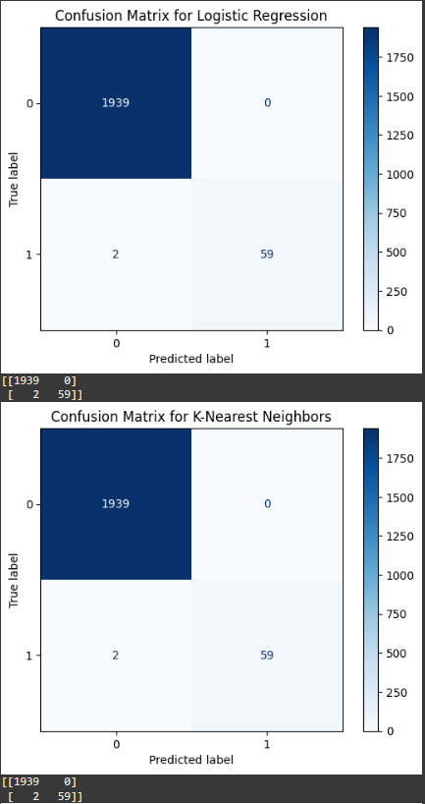
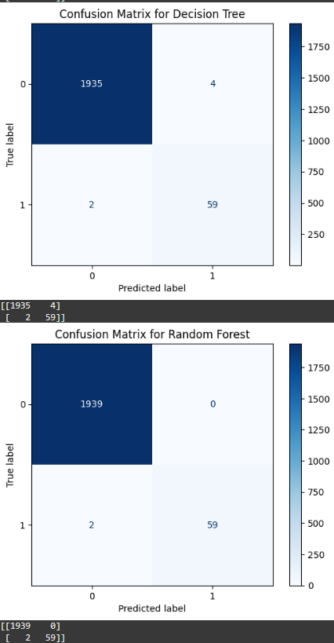
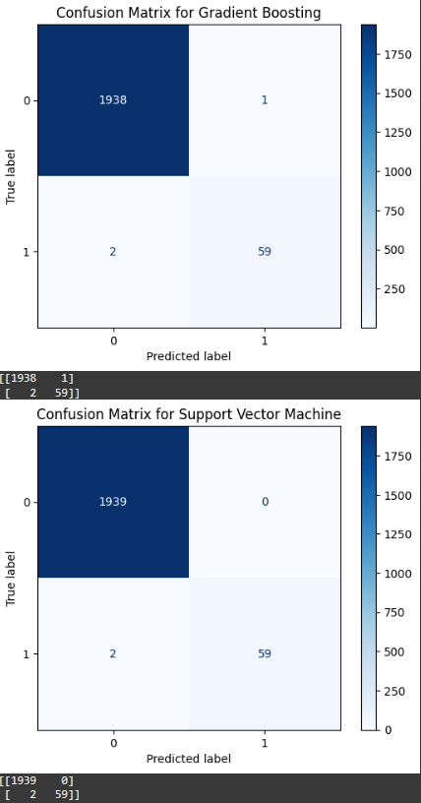
Confusion Matrix

Slide 29
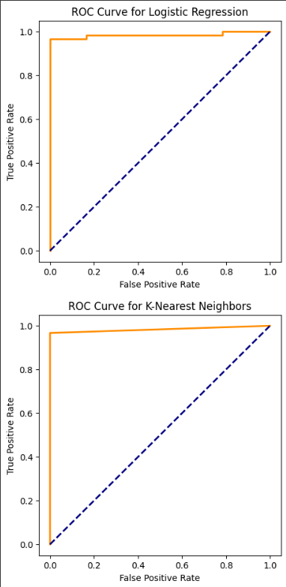
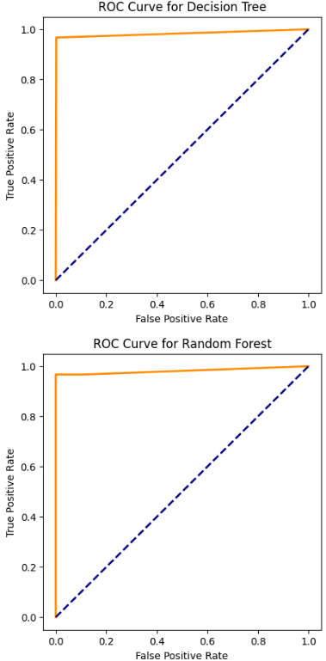
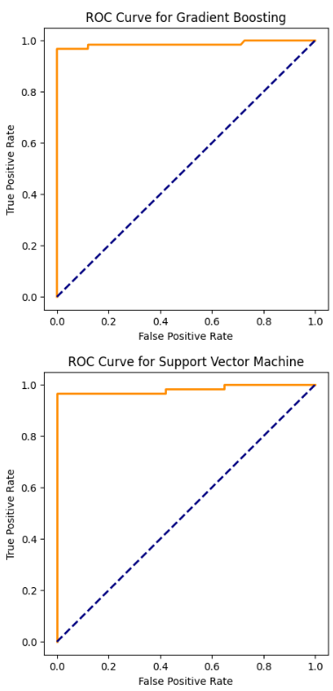
ROC Curve

Slide 30
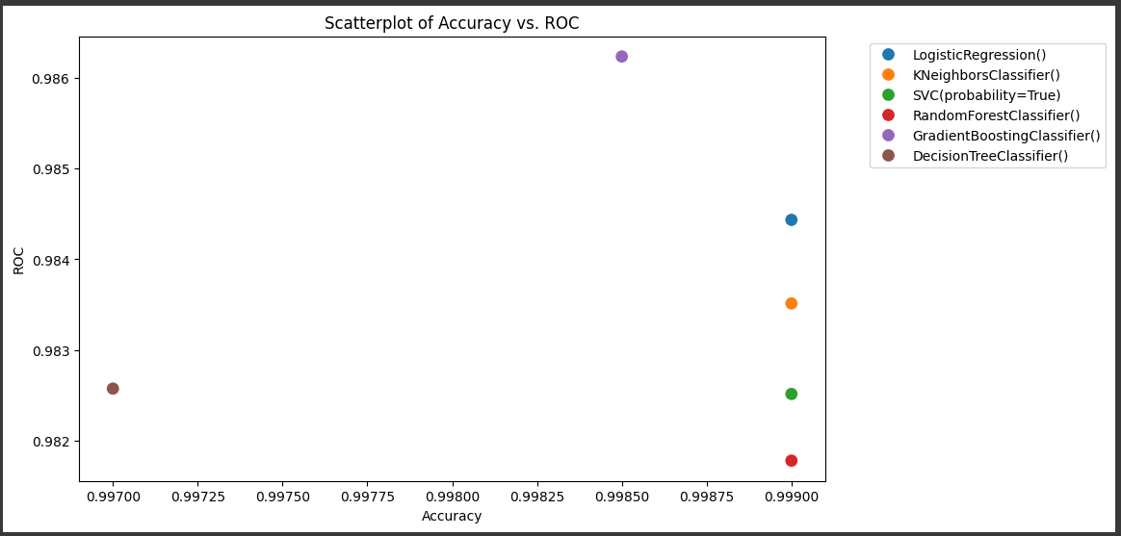
Trade-offs:
Random Forest (red) achieves slightly higher accuracy but lower ROC compared to Logistic Regression.
Decision Tree (brown) performs the worst on both metrics, indicating overfitting or lack of generalization.
Insights:
Except Decision Tree and Gradient Boosting all the models have similar accuracy. So, ROC metric was considered for the models with 0.99 accuracy.
Logistic Regression is the best candidate if prioritizing model quality for both metrics.
Model Placement:
Each dot in the scatter plot represents a model's performance based on Accuracy and ROC.
Best Model:
The Logistic Regression (blue) achieves the highest ROC (approximately 0.9844), indicating superior classification performance.
Its accuracy is slightly lower than the Random Forest Classifier (red), but ROC is more relevant for imbalanced datasets or critical binary classifications.

Slide 31
Model Deployment

Slide 32
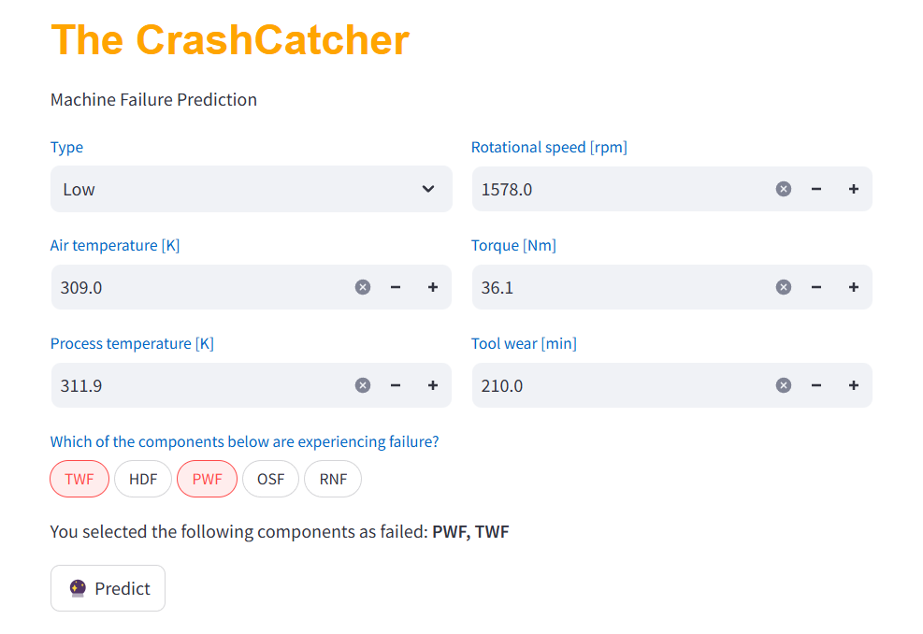
Deployed model and created user friendly web page using streamlit and named the model as “The Crashcatcher”.

Slide 33
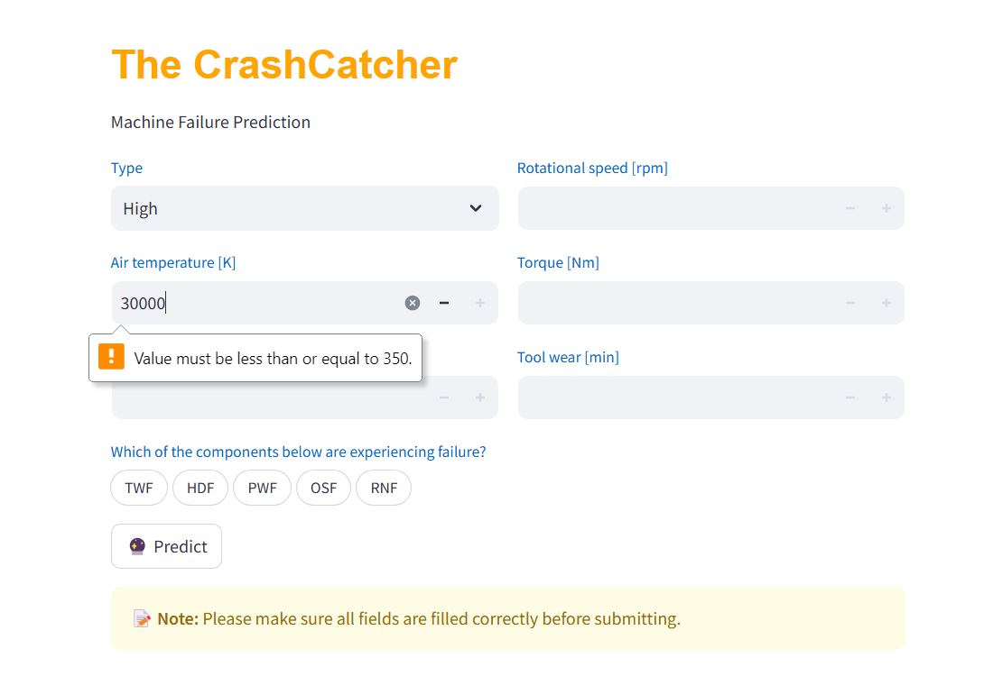
The Model throws a warning message, when the input value is more than the max value or when no value was keyed in the fields.

Slide 34
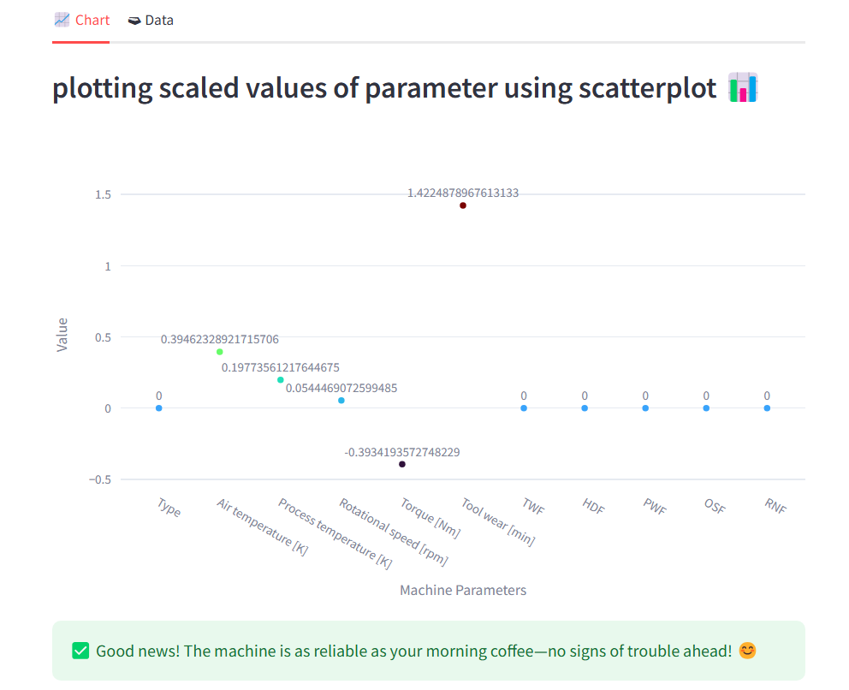
Once the prediction is done by the crashcatcher model. Users can see the plotted scaled values of each metrics given in the dataset in chart tab.

Slide 35
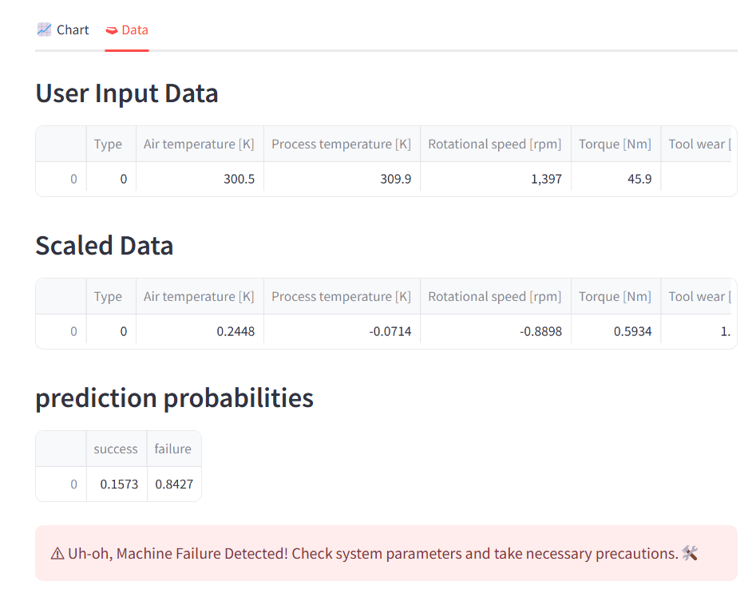
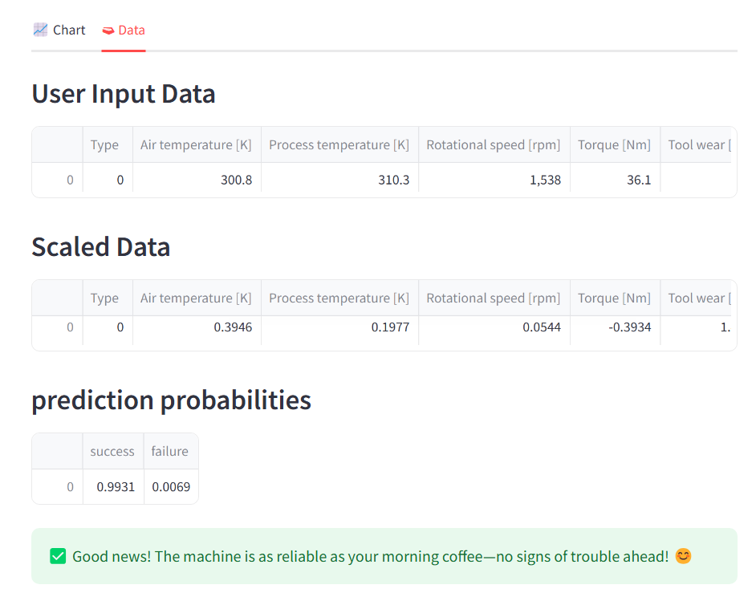
In Data tab, user input data, scaled user input data and the model prediction probability was displayed along with the machine status message

Slide 36
Challenges faced by Group
We faced issue during Model deployment part as we didn’t install the required packages prier.
We have scaled the target column and binary column too which yielded wrong result.
To overcome the above issue, the features were again scaled after dropping the target column and scaled, only the necessary columns.
During model deployment we also faced one more issue, the user input data has to be scaled before providing the data to the pre-built model for analysis.
This caused us to get wrong results to which was again corrected by dumping a separate pickle file scaler for pre-processing.
We remember that the app has to run locally to get the predictions even though the webpage is opened in chrome.

Slide 37
Packages used in the Project
Pandas : to load dataset
matplotlib.pyplot : visualisation
Seaborn: display heatmap
sklearn.preprocessing import StandardScaler : to scale the given data
sklearn.preprocessing import LabelEncoder : for label encoding
sklearn.linear_model import LogisticRegression: Logistic Regression Model
sklearn.neighbors import KNeighborsClassifier: KNN Model
sklearn.tree import DecisionTreeClassifier : Decision Tree model
sklearn.ensemble import RandomForestClassifier, GradientBoostingClassifier: Random Forest Model
sklearn.ensemble import GradientBoostingClassifier: Gradient Boosting Model

Slide 38
Packages used in the Project
sklearn.svm import SVC: SVC Model
sklearn.metrics import classification_report, roc_auc_score, confusion_matrix, ConfusionMatrixDisplay, roc_curve, accuracy_score : Performance metrics to analyze models
sklearn.model_selection import GridSearchCV: to find optimized values for hyper parameter
Joblib: Dumping and storing the model. joblib is faster in saving/loading large NumPy arrays, whereas pickle is faster with large collections of Python objects
Flask: model deployment
flask import render_template: to render index.html web page

Slide 39
The Impact: A Win for the Business
Costs are Reduced: Preventative actions lower repair and downtime costs.
Productivity is Maximized: Machines stay operational longer.
Customer Satisfaction Increases: On-time deliveries ensure repeat business.

Slide 40



